Slide 1
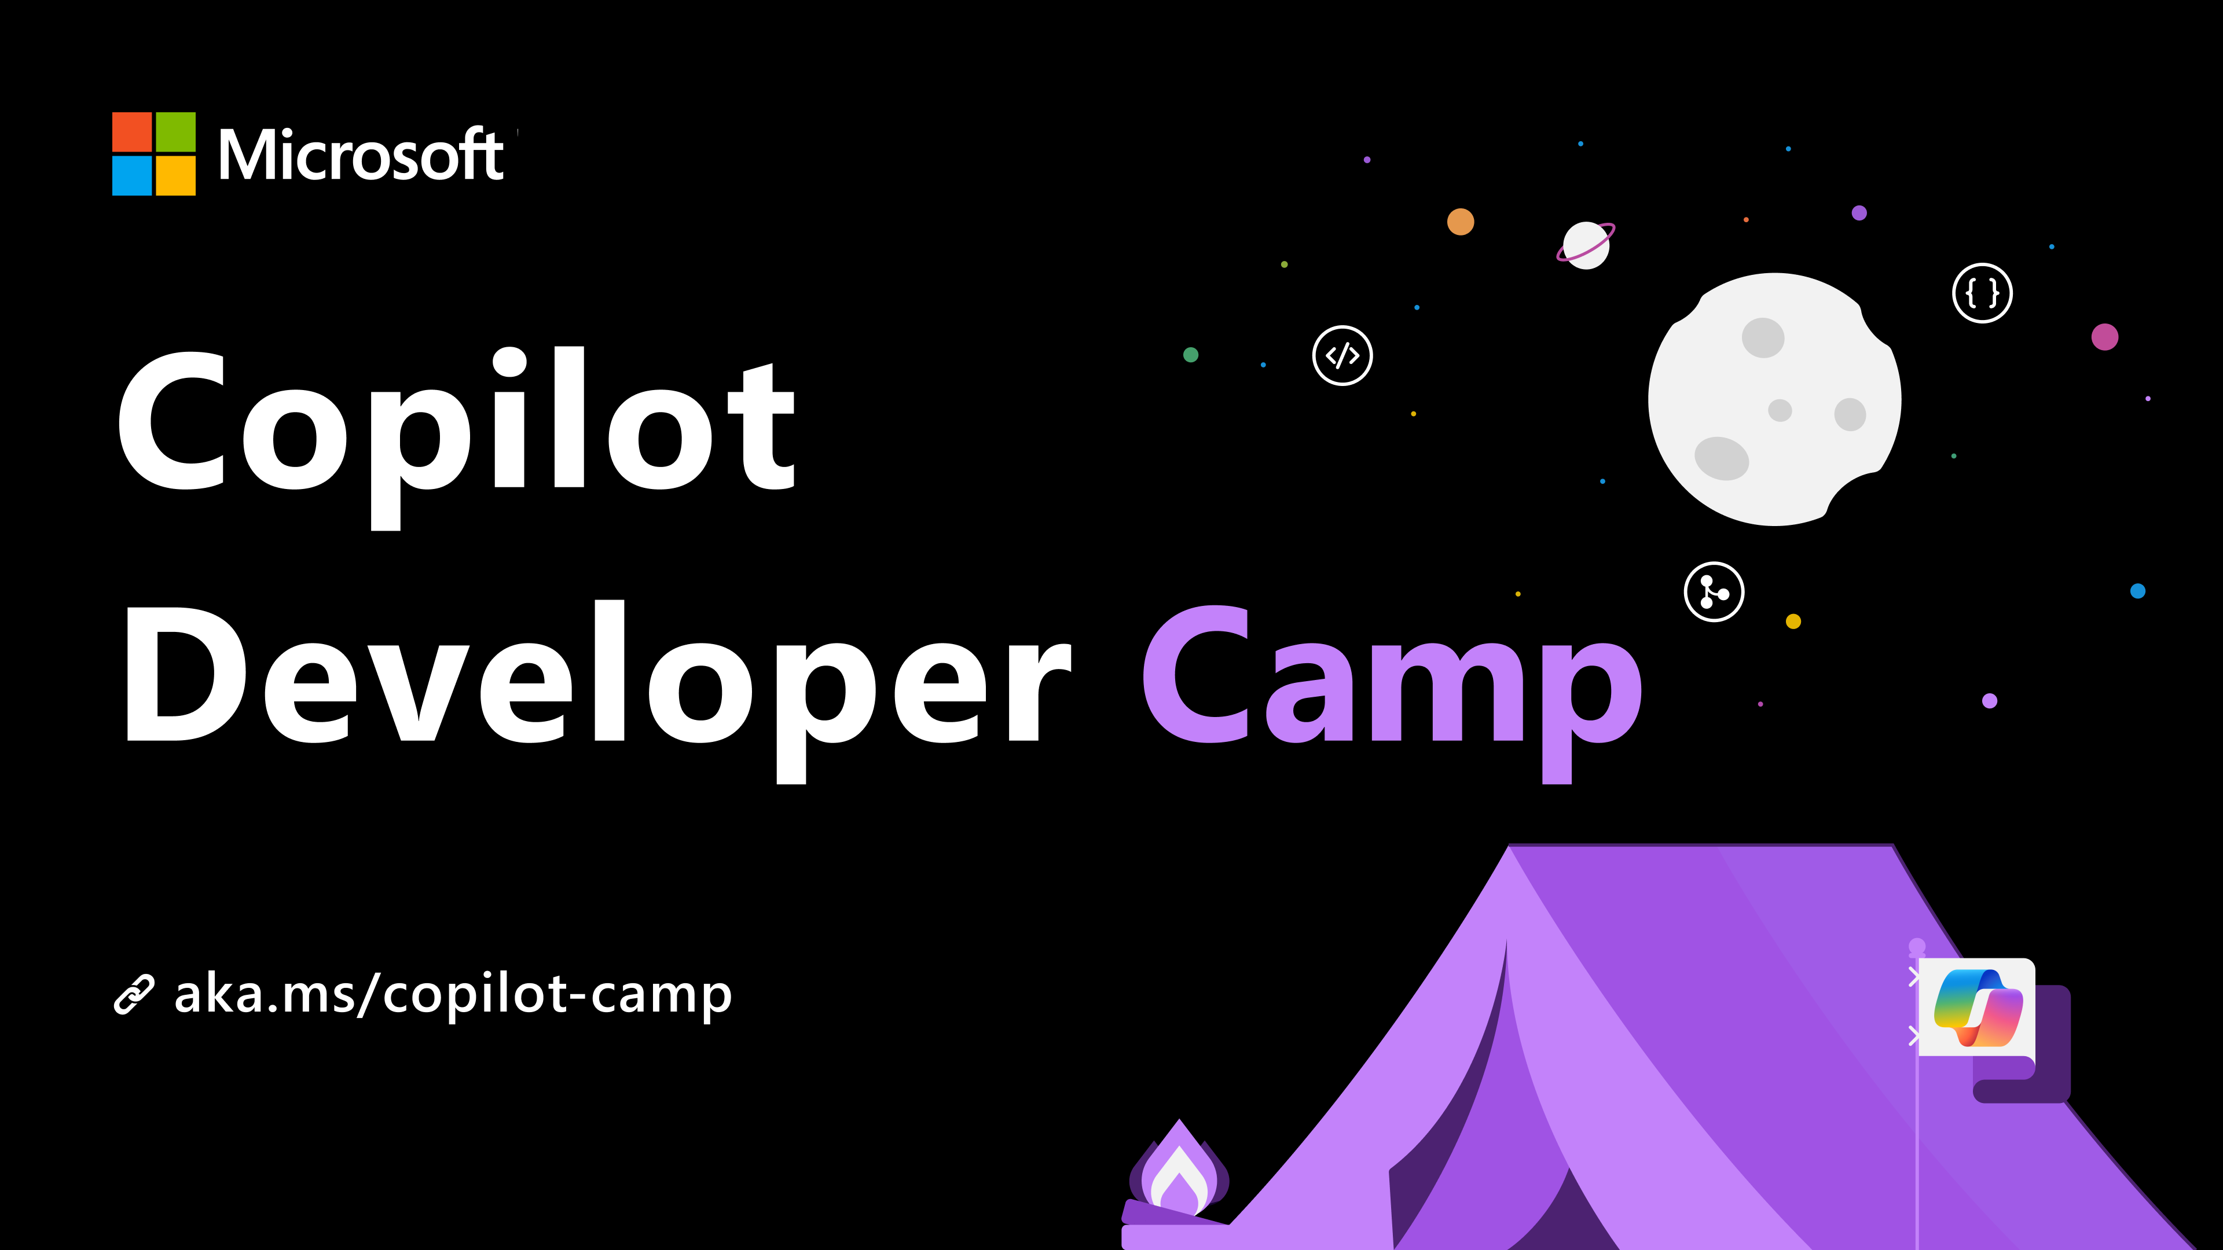

Slide 2
Building Microsoft 365 Copilot Agents
Notes:
Welcome to Copilot Developer Camp!
We’re excited to have you here as we explore how to extend the power of Microsoft 365 Copilot by building intelligent, task-oriented agents that integrate seamlessly into the Microsoft 365 ecosystem.
In this session, we’ll walk you through the core concepts, tools available, the structure of the available labs, and how you can start building agents today no matter your experience level, using the Copilot Developer Camp labs.
Let’s dive in and discover what’s possible with Copilot Agents!

Slide 3


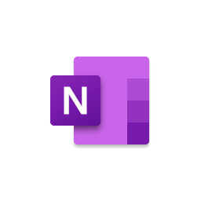











Microsoft 365 Copilot
Natural Language
Large Language Models
Microsoft 365 Apps
Microsoft Graph*
Microsoft Dataverse*
Web
*Grounded out-of-box in your personal and company data from Microsoft Graph & Microsoft Dataverse
Notes:
But first let’s take a step back. What is Microsoft 365 Copilot. May have seen it across your Microsoft 365 apps surface areas ( Teams, word, excel, PowerPoint, outlook one note all the pap icons I’ve listed here).
It is your AI assistant at work. In outlook, you can ask Copilot to triage your inbox, and summarize really long email threads for you. IN teams, ask for meeting summary or key action items.
Copilot has the foundational capabilities of large language models, web grounding with real time, up-to-date knowledge of the internet, it is grounded out of box in your personal and company data from Microsoft Graph and Microsoft Dataverse. So it knows about you and your organization across Microsoft 365 apps (such as your emails, chats, documents you have permissions to access, calendar details), as well as compliance, security, identity and privacy policies.
In Teams, you may have missed a number of important meetings, you can ask copilot for a summary of the meeting, and also ask copilot specific questions that were discussed in the meeting, what questions are unresolved. Was my name mentioned in this meeting recording. Copilot will provide citations on how it drew the conclusions and the transcriptions, so I could go back and listen to the recording.
In Powerpoint, I could ask Copilot to start a new ppt presentation on a project milestone update, I can ask copilot to make this ppt slide more visual, can you add animations to this slide. Copilot even generates speaker notes for the slides.
In Excel, I can ask copilot to help analyze data, and give me top three trends. You can ask copilot a follow up question about the trend. It’ll generate a new sheet, you can ask copilot to visualize the sheet, and you can ask copilot to create a model for a what if model, and it’ll explain a step by step how it created the model.
In the Copilot chat, you can also ask generic questions, like what’s the latest status on this Project Contonso. Copilot is grounded in my M365 data, it can access my emails, sharepoint documents, ppt files, calendar meetings, conversations on teams, to look for relevant data, and summarize it for me.
But here you will learn how to go beyond that and build Copilot agents that are specific to your business.

Slide 4
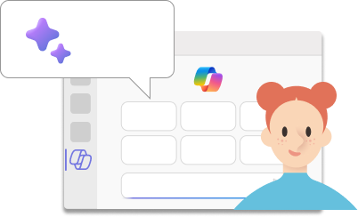

You can ask Copilot for Microsoft 365 to:
Summarize chat conversations in Teams from the past n days
Draft email messages
Create a meeting agenda, based on the past meetings
Draft a project proposal based on data from your documents and spreadsheets
…and so on!
Copilot clients:
M365 Chat
Teams
Outlook
Word
PowerPoint
Excel…
Notes:
Here are some examples of how people use Microsoft 365 Copilot out of the box
But here you will learn how to go beyond that and build Copilot agents that are specific to your business.

Slide 5






Microsoft 365 Apps
Microsoft 365 Service Boundary
Response
+
app commands
Customer data is not stored or used to train the model
Azure OpenAI
instance is maintained by Microsoft. OpenAI has no access to the data or the model.
1
6
Large Language Model
“What are the milestones for Project Falcon”
User prompt
Modified prompt
Azure OpenAI
Pre-processing
3
2
4
RAI
Microsoft Graph
Grounding
3
LLM Response
RAI is performed on input prompt and output results
5
Microsoft 365 Copilot
Semantic
Index
Grounding
Post-processing
Data flow ( - all requests are encrypted via HTTPS and wss://)
Your context and content
emails, files, meetings, chats,
calendars, and contacts
1
User prompts from Microsoft 365 apps are sent to Copilot
Copilot accesses Graph, (optional) web + other services for pre-processing
Copilot sends modified prompt to Large Language Model
Copilot receives LLM responses
Copilot accesses Graph for post-processing
Copilot sends the response, and app command back to Microsoft 365 apps
2
3
Customer Microsoft 365 Tenant
4
5
6
Notes:
The first thing is, I ask a question which is the user prompt. And I can do this across any of the copilots in Microsoft 365 apps. This prompt gets sent to the copilot orchestration engine. The orchestration engine is what powers all of our copilot scenarios. It doesn't just send the question directly to the LLM.
The first step is, which is very important piece, which is pre-processing. This is where orchestrator does grounding, grounding is the way where we get enough information to answer the question accurately. It’s a big part of how we don’t hallucinate.
And the way it gets more information is by calling Microsoft Graph. So copilot only has access to what the user has access to. Admins can also further apply additional permissions from the source system to M365 copilot as well.
All of the indexing on relationship, relevance, ranking of the content is done through Semantic Index. It's a sophisticated map of all data and content in your organization to enable copilot to deliver more relevant responses..
Once the orchestration engine says I have enough information to answer the question. It takes your question, the additional grounding data and sends it in a modified prompt to the LLM to give the LLM enough information to generate a response.
The LLM will generate a response, and the next step, which is another very important step, which is the post processing step. We do additional grounding where we call Microsoft graph, validate the responses are accurate. Make sure we have the right references and citations, and also check the response isn’t generating harmful content and is still maintaining our commitment to being ethical and fair.
Once the orchestration engine decides that there’s enough to give a good response. It responds back to the App.
This is a very linear flow. The orchestration engine is an iterative process, it could call the graph multiple times, can call multiple other skills.
None of the prompts, responses data is used to train the LLMs. Data generated remains within your company's tenant, and complies with your existing compliance, security, identity, privacy policies. All of this flow happens within the M365 compliance boundary and you see the LLMs are also private instances within the Microsoft 365 compliance boundary.
This is flow is a pretty simple flow where you saw the orchestration engine gets some additional grounding data from Graph, but what I love, and it’s the purpose of this sessions, is that you can make the orchestration engine more powerful by customizing it, and connecting it with additional grounding data with graph connector, and adding more functionalities like plugins.

Slide 6
Tailor to your organization with Copilot agents
Natural Language
Large Language Models
Microsoft 365 Apps
Microsoft Graph
Microsoft Dataverse
Web
Copilot agents
Notes:
In Sept 2024, we announced Wave 2 of Microsoft 365 Copilot. One of the big things they announced was the idea of Copilot Agents; in this developer camp, you’ll learn how to build these agents.

Slide 7

+ Copilot agents
Business Apps
Microsoft 365 Copilot can be extended using Copilot agents to bring custom knowledge, skills, and process automation
Skills
+
Copilot for Microsoft 365
Microsoft 365 apps
Knowledge
Microsoft 365 data
+
Business Knowledge
+
Web Knowledge
Notes:
Copilot agents provides the ability to customize and extend Microsoft 365 Copilot with additional knowledge and skills to achieve specific work functions.

Slide 8


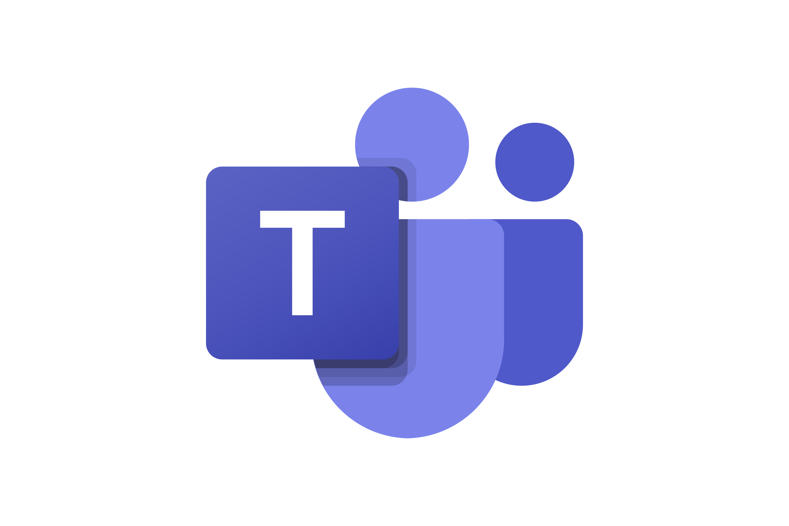


Building agents in Microsoft 365
Extending Microsoft 365 Copilot
low-code
Agent Builder
Copilot Studio
no-code
pro-code
SharePoint Agents
Agents Toolkit
Microsoft 365 Copilot
Notes:
Here you can understand the whole spectrum of possibilities when it comes to extend Microsoft 365 Copilot with agents
You can have no-code solutions like SharePoint agents and Agent Builder.
You can have low-code solutions with Microsoft Copilot Studio.
You can have pro-code solutions with Visual Studio Code and the Microsoft 365 Agents Toolkit.

Slide 9
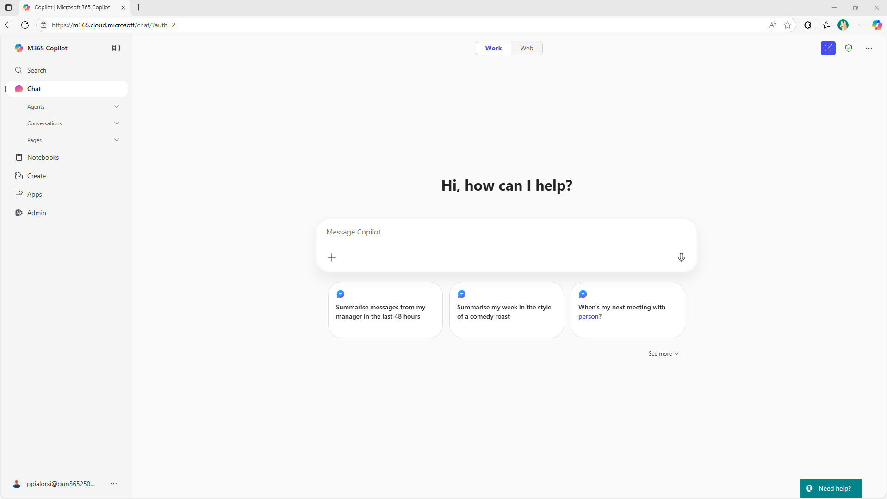
Open/Close panel
BizChat
Notes:
First a bit of terminology.
This familiar view of Copilot is called “BizChat” – it’s the chat user interface used by Microsoft 365 Copilot across all the applications
Now you can open a panel to see the available agents and additional functionalities.

Slide 10
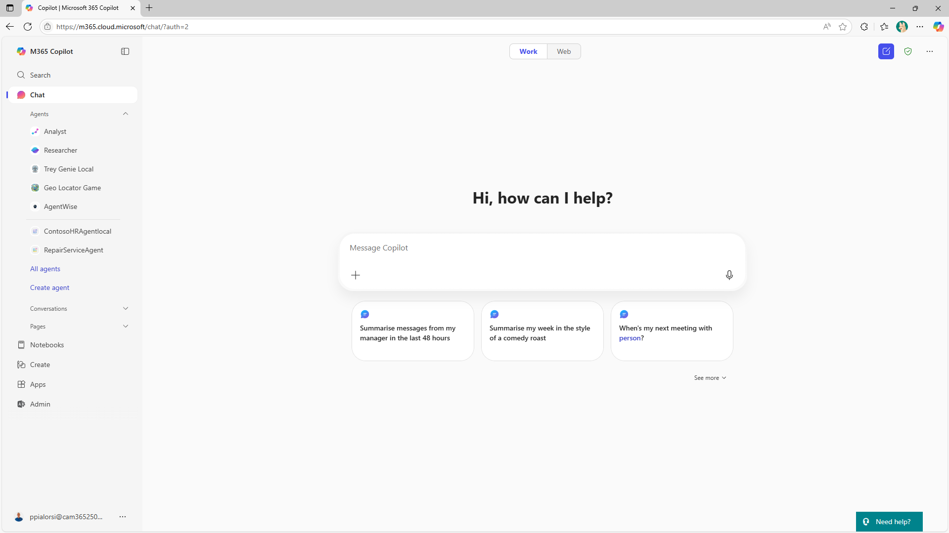
Agents
Notes:
Here are the agents. You can click one to get the “Immersive” experience.

Slide 11
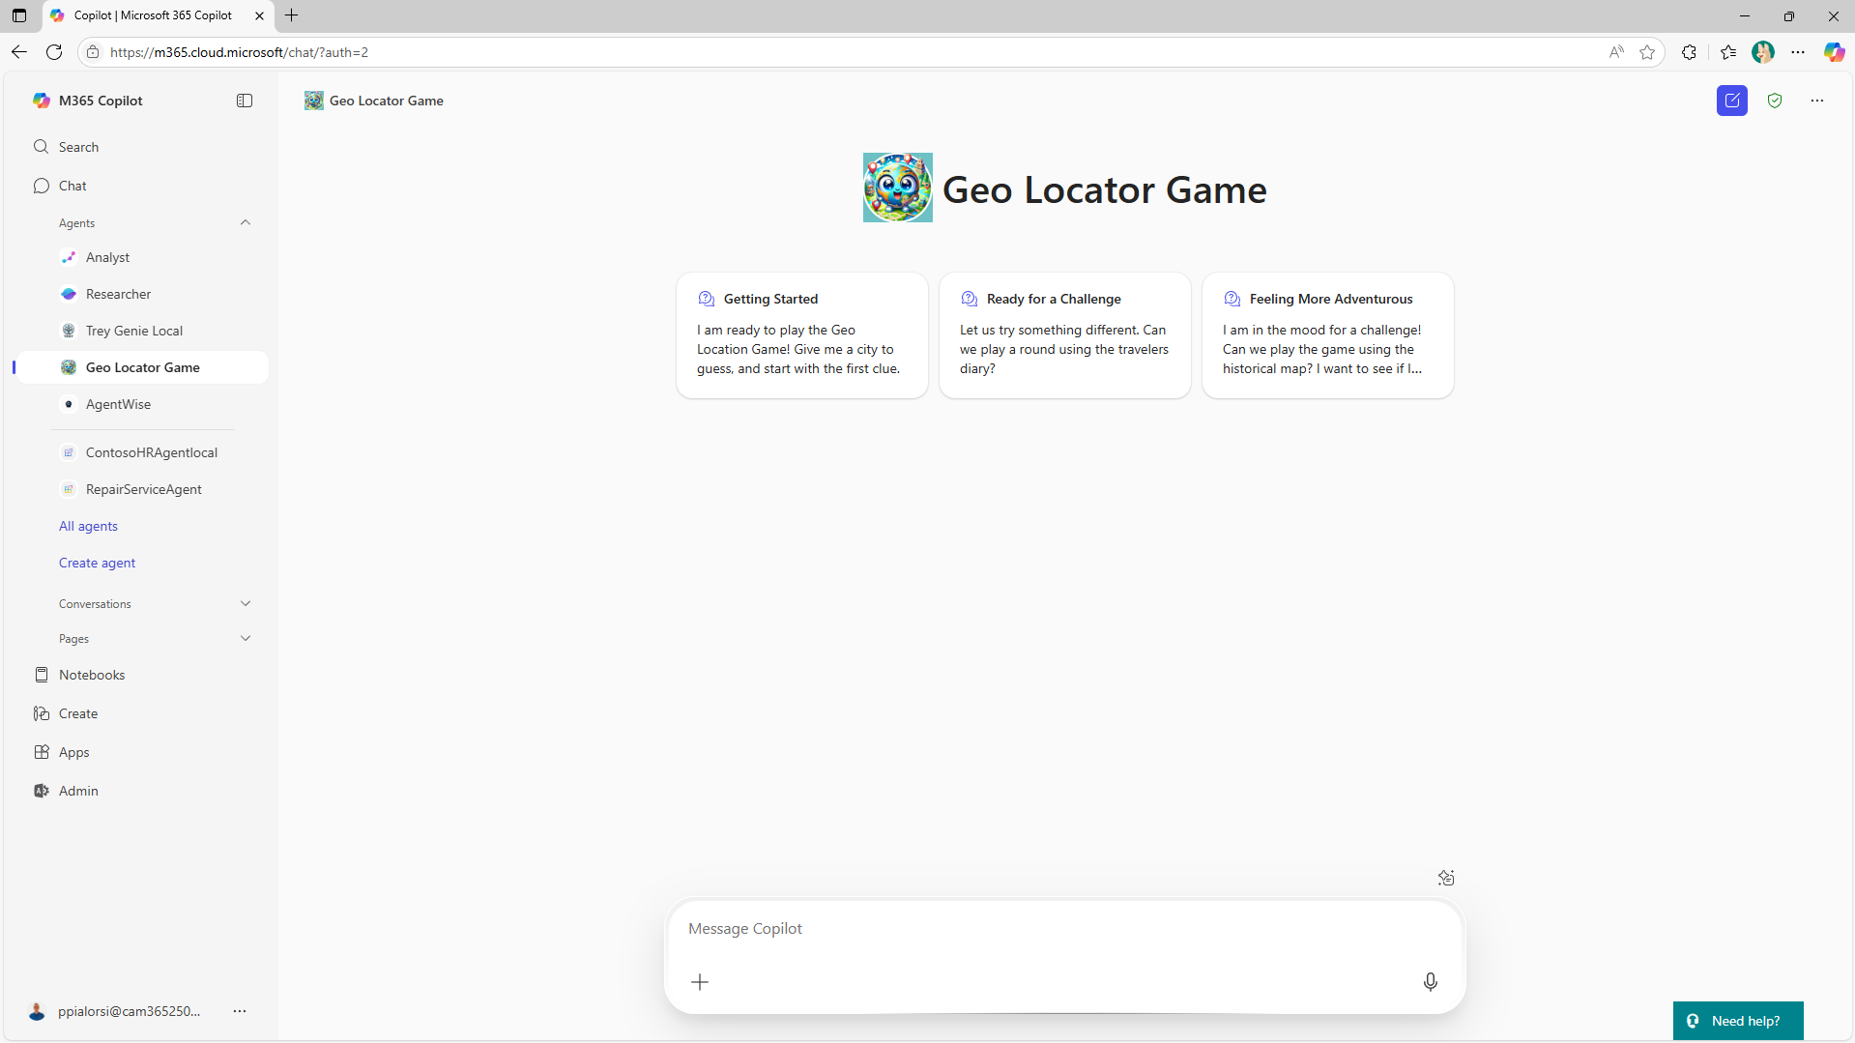
Immersive experience
Notes:
In the immersive experience the agent has its own branding and prompt suggestions. Users can speak to it as they would speak with a human expert.

Slide 12
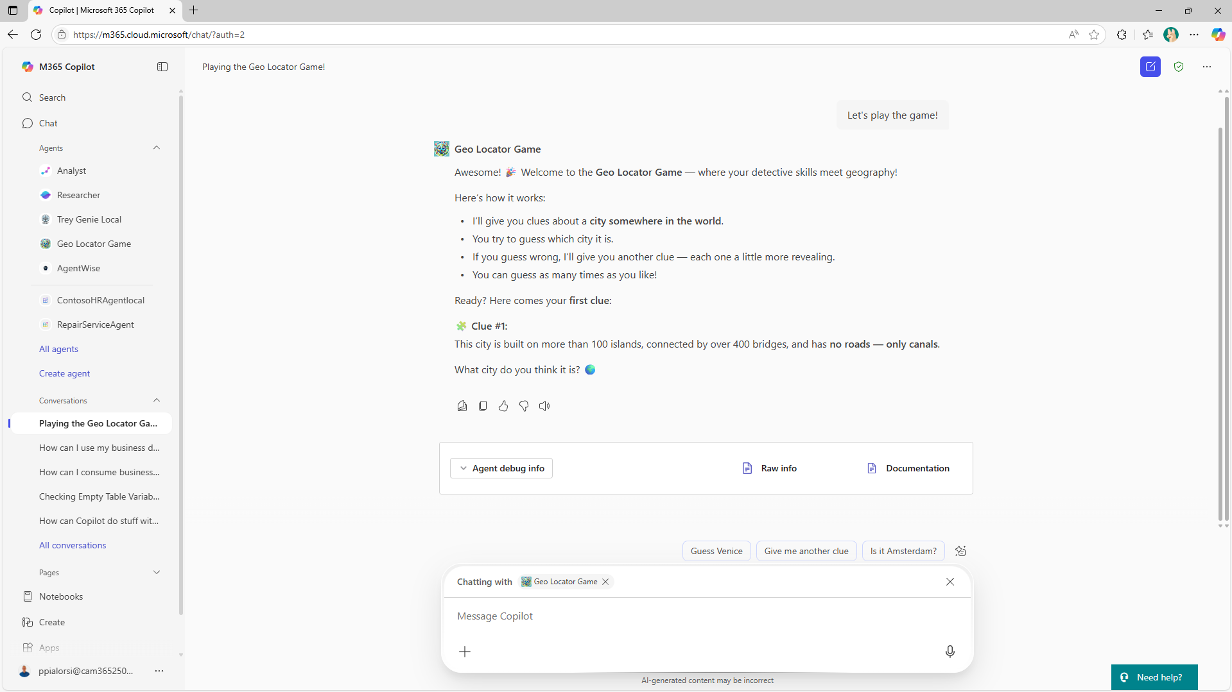
In context experience
Notes:
You can also @ mention an agent to bring it into conversations and into the general Bizchat UI. This is called the In Context experience.

Slide 13






Build agents on your terms
Declarative agents
Custom engine agents
Built and run on Microsoft 365 Copilot
Built and run on your custom AI engine
Declare instructions, actions, and knowledge sources
Full control over orchestration, models and more
Deploy across
Deploy across
No code
Pro code
Notes:
There are two approaches to building AI agents, emphasizing flexibility and control. Declarative agents, built on Microsoft 365 Copilot, allow users to easily declare instructions, actions, and knowledge sources without coding, making deployment across Microsoft 365 Copilot, SharePoint, and Teams straightforward. On the other hand, custom engine agents offer advanced developers full control over orchestration, models, and integration, supporting deployment not only on Microsoft 365 Copilot and Teams but also on custom web interfaces and multiple messaging channels like SMS and Email. The agents can be built from no-code to pro-code tools, catering to different skill levels and needs. This empowers organizations to choose the best fit for their AI development strategy, balancing ease of use with customization and scalability.

Slide 14
Agent components
User experience (optional)
Orchestrator
Knowledge
Grounding and memory
Agents
Tools
Your LOB applications and APIs
Easily tailor your agent’s building blocks to meet your unique business needs in a comprehensive, end-to-end studio.
Autonomy
Planning, exceptions, etc.
Foundation models
Notes:
Let’s look at the anatomy of an agent. The central 'Orchestrator' acts as the core, coordinating interactions between foundational models, knowledge bases, tools, and optionally, the user experience layer. This setup allows businesses to customize and tailor each building block of their agents to precisely fit their unique operational requirements.

Slide 15

Declarative Agent components
User experience
Orchestrator
Knowledge
Grounding and memory
Agents
Tools
Your LOB applications and APIs
Autonomy
Planning, exceptions, etc.
Microsoft provided
Foundation models
Developer provided
Notes:
Here you can see the same agent component breaks down now highlighting the core elements of declarative agents., clarifying which components are provided by Microsoft and which are developed by users, emphasizing the extensibility and customization possible within this architecture.

Slide 16
Custom Engine Agent components
User experience
Orchestrator
Knowledge
Grounding and memory
Agents
Tools
Your LOB applications and APIs
M365 Agents SDK
Autonomy
Planning, exceptions, etc.
Foundation models
Notes:
Here you can see the same agent component breaks down now highlighting the core elements of custom engine agents., clarifying which components can be developed by users, emphasizing the maximum extensibility and customization possible within this architecture. This also illustrates the advantage of using the M365 Agents SDK, which enables your agent to be accessed across multiple channels

Slide 17
Custom Engine Agent for Teams components
User experience
Orchestrator
Knowledge
Grounding and memory
Agents
Tools
Your LOB applications and APIs
Teams AI Library
Autonomy
Planning, exceptions, etc.
Foundation models
Notes:
Here you can see the same agent component breaks down now highlighting the core elements agents for Teams., clarifying which components can be developed by users, emphasizing the maximum extensibility and customization possible within this architecture. This agent is only available through Microsoft 365 Copilot and Microsoft Teams.

Slide 18
Agent tooling covered in Copilot Dev Camp labs
Makers
Coder
No code
Pro code
VS Code | Visual Studio Microsoft 365 Agents Toolkit
Copilot Studio
Agent Builder
Copilot Studio
Declarative Agent
Custom Engine Agent
SharePoint Agent
Agent for Teams
Notes:
Let’s take a look at the the range of agent development tools featured in the Copilot Dev Camp labs, organized by skill level and coding requirements. Starting with no-code options, tools like Copilot Studio Agent Builder and SharePoint Agents enable users to create agents without programming knowledge. Moving into the makers category, Copilot Studio offers more customization while still being accessible. For professional developers, the coder tools include VS Code, Visual Studio, and the Microsoft 365 Agents Toolkit, providing robust environments for building complex agents.

Slide 19
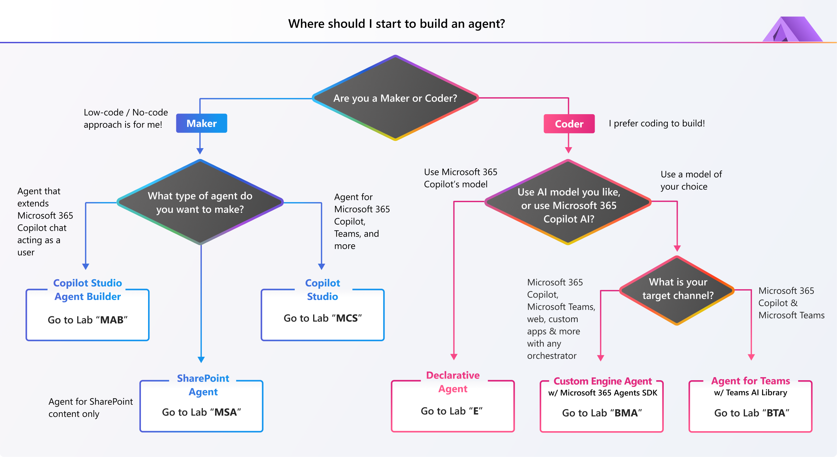
Notes:
This flowchart is designed to guide users in choosing the best starting point for building an AI agent based on their skill set and goals. For Makers, who may prefer low-code or no-code solutions, Microsoft 365 Copilot or Copilot Studio are recommended as accessible tools to quickly create intelligent agents.
Coders, on the other hand, have a broader range of options including leveraging AI models directly, building custom engines, or utilizing specific software development kits (SDKs) and toolkit.

Slide 20
End user focus: Prompt Engineering Labs
Prompt Engineering
Level 1 – Instruction only agent
Coming soon
Level 2 – Enterprise scenario
aka.ms/copilot-prompt-library
Find inspiring samples for prompts here:
Notes:
We’ve also included prompt engineering guidance for end users. In our 'Level 1' lab under “Prompt Engineering”, users work with an instruction-only agent to iteratively refine prompts using a simple scenario.
More advanced labs are on the way, focusing on real-world enterprise use cases with complex workflows handled through agent instructions.

Slide 21
https://aka.ms/CopilotDevCamp
Notes:
Checkout Copilot Developer Camp labs using this link and start building agents for Copilot today!

